Slide 1
A Software developer’s guIde to desıgnıng better software apps:
Key Strategies and Best Practices
Nurhak Kaya

Slide 2
Agenda
Introduction
Complexity in Software Design
Working Code isn’t Enough
Abstraction in the form of Simple Interfaces
Plan Before Build
Reusability and Consistency
Sustainable and Accessible Design Right from the Start
Final Notes and Q&A

Slide 3
Introductıon
Hi! My name is Nurhak Kaya.
Solution Architect at Wattle (https://www.wearewattle.com/)
Umbraco MVPx3, Umbraco Certified Master, Scrum Master
Author of multiple tech articles
Open-source contributor, speaker, event organiser

Slide 4

Complexıty ın Software Desıgn

Slide 5
“The greatest limitation in writing software is our ability to understand the systems we create.”
“The larger the program and the more people work on it, the more difficult it is to manage complexity.”
“Simpler design allows us to build large and more powerful systems before complexity becomes overwhelming.”
John Ousterhout, Stanford University, A Philosophy of Software Design

Slide 6
“Complexity isn’t caused by a single catastrophic error; it accumulates in lots of small chunks.”
“Eventually, there are so many of these small issues that every possible change to the system is affected by several of them.”
John Ousterhout, Stanford University, A Philosophy of Software Design

Slide 7

Elımınatıng Complexıty

Slide 8
Elımınatıng complexıty
Good development tools can help us deal with complexity, but they are not enough.
One approach is to eliminate complexity by making code simpler.
The second approach is the modular design.
Encapsulate the more complex code so that programmers can work on a system without being exposed to all of its complexity at once.
Relatively independent modules so that programmers can work on one module without having to understand the details of other modules.

Slide 9
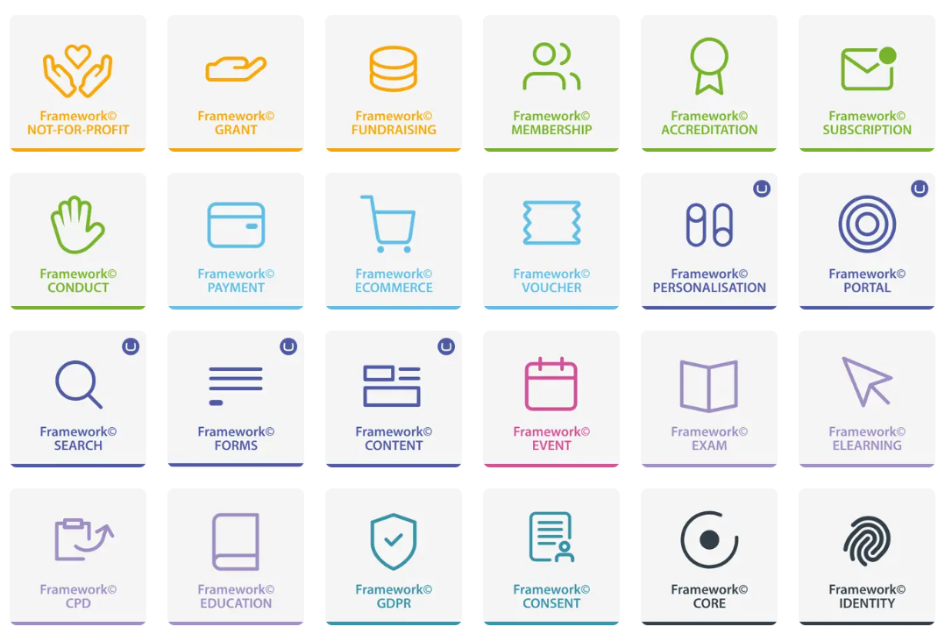
Modules, blocks, frameworks
Modular programming is a software design technique that emphasizes separating the functionality of a program into independent, interchangeable modules.
If a piece of code can be independently created and maintained to be reused in different systems, that should be a module.
Building Blocks

Slide 10
Modules, blocks, frameworks
A module...
encapsulates functionality and data.
Encapsulation is about hiding the implementation details of a module.
The less a module knows about other modules, the less dependent it will be on changes in other modules.
Other modules can only access functionality and data via the provided interface.
Encapsulate as much as possible.

Slide 11
Modules, blocks, frameworks
A module...
provides an interface.
Other modules use the interface for accessing the module’s functionality and data.
The software module interface should be as abstracted and as small as possible.
Fewer details mean looser coupling between software modules. This makes them more independent, reusable and interchangeable.

Slide 12
Modules, blocks, frameworks
A module...
requires interfaces provided by other modules.
Modules must sometimes use the provided interfaces of other modules. This creates a dependency between modules.
The fewer dependencies, the better.

Slide 13
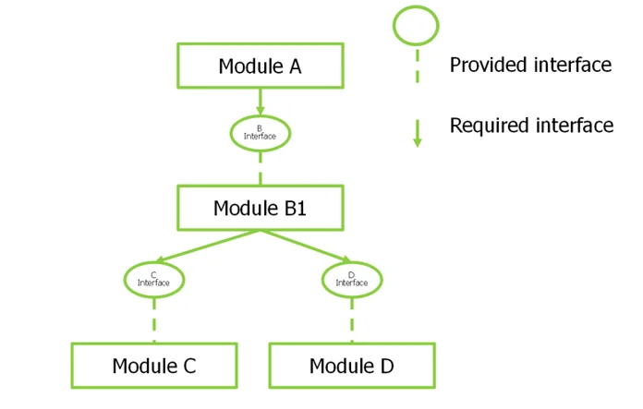
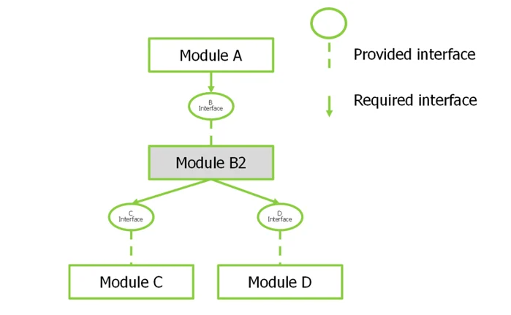
Independent, reusable and ınterchangeable module
Module B1 provides Interface B to Module A. It’s also dependent on Module C and Module D via Interface C and Interface D.
Module B2 is an improved version of Module B1. Module B2 provides the same Interface B and requires the same Interface C and Interface D.
Module B1 is interchangeable with Module B1.

Slide 14

Talkıng about module ınterfaces...
Car key in ignition: abstraction in the form of a simple interface
Interfaces describe what a module does but not how it does it.
Best modules are those whose interfaces are simple.
As long as the interface doesn’t change, modified modules won’t affect the other dependent modules.

Slide 15
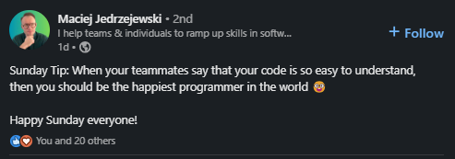
Methods
Methods should have a clean and simple interface so that users don’t need to have much information in their heads to use it correctly.
Splitting up a method is a good idea to create a cleaner abstraction or make it easier to read the code.
A good method can be long.

Slide 16

Complexıty ıs ıncremental

Slide 17

Complexıty ıs ıncremental
Modular design helps with fighting complexity, but complexity is incremental.
It is (generally) not caused by a single major error.
Complexity comes about because hundreds or more of small dependencies build up over time.
Eventually, there are so many issues that it is harder to implement new features or maintain the existing ones.

Slide 18

As Complexıty ıncreases...
It is more difficult and risky to modify an existing code base.
It takes more code changes to implement new features.
Developers spend more time understanding an existing system to make code changes safely.
Developers might not be able to find all the information that they need.

Slide 19

Workıng code ısn’t enough.

Slide 20

Strategıc vs. Tactıcal programmıng
One of the most important elements of good software design is the mindset you adopt when you approach a programming task.
Many organisations encourage a tactical mindset, focused on getting features working as quickly as possible.
If you want a good design, you must take a more strategic approach where you invest time to produce clean designs and fix problems.
Tactical thinking centres on immediate actions on problem-solving.
Strategic thinking focuses on the larger context, predicting future trends and decisions for enduring success.
Notes:
Tactical programming: The main focus is to get something working as quickly as possible (due to deadlines, etc.).
It is short-sighted – you don’t spend much time looking for a better design.
Short-cuts and smelly code are common.
The mindset tells you that it is OK to add some complexity to complete tasks quickly.
One particular complex code might not make the system complicated, but the accumulation of many small changes will create complexity.

Slide 21
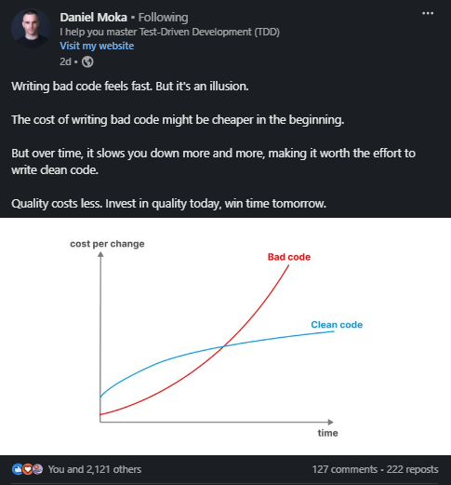
Tactıcal programmıng leads to bad code
Notes:
Tactical programming: The main focus is to get something working as quickly as possible (due to deadlines, etc.).
It is short-sighted – you don’t spend much time looking for a better design.
Short-cuts and smelly code are common.
The mindset tells you that it is OK to add some complexity to complete tasks quickly.
One particular complex code might not make the system complicated, but the accumulation of many small changes will create complexity.

Slide 22
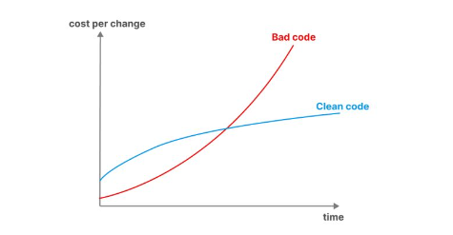
Strategıc programmıng – an ınvestment mındset
The primary goal is to produce a great design.
Invest time to improve the design of the system, rather than taking the fastest path to finish a project.
These investments will slow you down a bit initially, but they will speed you up in the long term.

Slide 23
How much to ınvest?
10-20% of total development time.
The initial projects will take 10-20% longer than they would in a tactical approach, but this will also result in better design.
Most projects start benefiting from better design within a few weeks or months.
It won’t be long before you start delivering new features 10-20% faster than you would if you had programmed tactically. This is the point when investments become free.

Slide 24
Whıch approach to choose?
Always depends on the project, time and resources.
Choosing a tactical approach at the beginning will make it more difficult to switch to a strategic approach.

Slide 25
Plan before buıld

Slide 26
Plan before buıldıng ıt.
Do not pick the first idea that comes to mind. Consider multiple options, especially for major design decisions.
High-level planning first, then focus on the details.
Tech review all of the requirements.
Give the Development Team time and resources to raise their issues and understand the necessary changes before they start delivering them.
Clear communication within the team and with the client is crucial to the success of most projects.
Notes:
Tactical programming: The main focus is to get something working as quickly as possible (due to deadlines, etc.).
It is short-sighted – you don’t spend much time looking for a better design.
Short-cuts and smelly code are common.
The mindset tells you that it is OK to add some complexity to complete tasks quickly.
One particular complex code might not make the system complicated, but the accumulation of many small changes will create complexity.

Slide 27
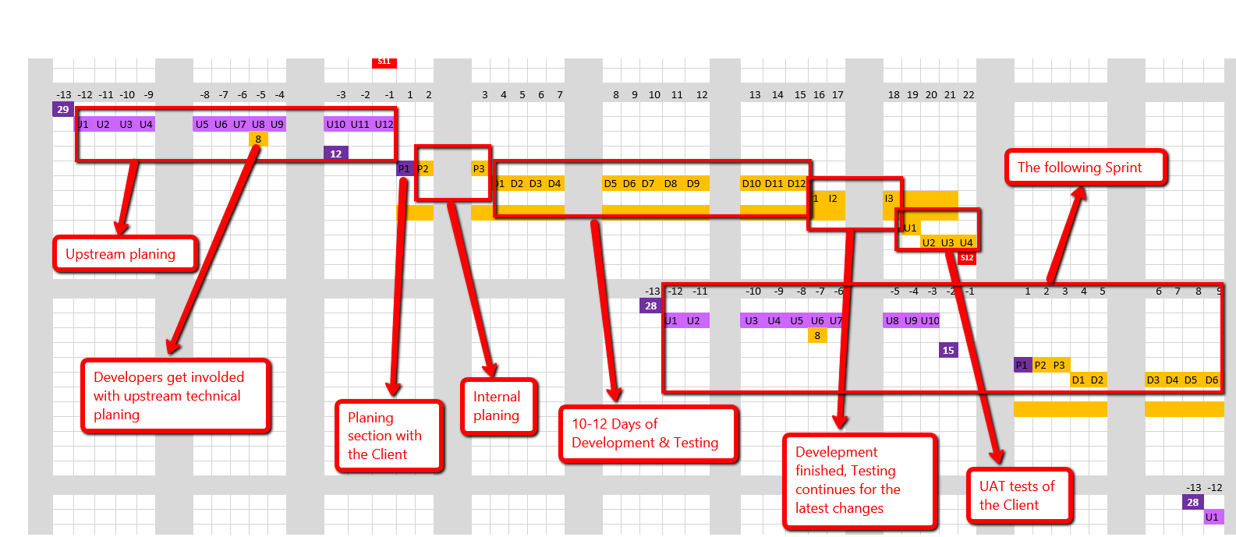
Plan before buıldıng ıt.

Slide 28

Consıstency

Slide 29
Consıstency buılds trust
Trust gives us a reason to believe that we can expect alike experiences every time we use or do something.
Code consistency plays a crucial role in the development of software applications. It ensures that code is written in a uniform and standardized manner, making it easier to read, understand, and maintain.
Similarly, design patterns provide a unified approach to solving specific problems, leading to greater consistency across the application and making it easier for new team members to get up to speed.

Slide 30

Sustaınable and Accessıble Desıgn

Slide 31
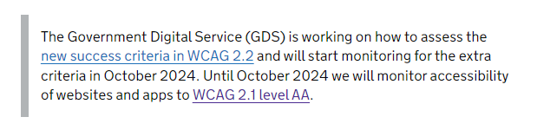
Accessıble Desıgn Rıght from the Start
An inaccessible app is not just annoying to users, but it also puts your (your client’s) business at risk.
Poor accessibility will lead to poor user experience, which can directly affect your (your client’s) business’s bottom line.
All UK public sector bodies have to meet the 2018 requirements unless they are exempt. Public sector bodies include
Central government and local government organisations
Some charities and other non-government organisations
Notes:
Follow the W3C Guideline to make accessibility your priority.
Creating accessibility products right from the start will help you meet Web Content Accessibility Guidelines (WCAG) and add direct value to your (your client’s) business as more people will be able use them.

Slide 32
Sustaınable Desıgn Rıght from the Start
Create internal sustainability guidance to follow the best practices to build sustainable projects from the very beginning of projects.
This includes:
Hosting infrastructure
Software architecture
Creative and design approaches
User experience design
Low carbon mode to activate low-carbon mode
Upgrading projects have a positive impact on creating more sustainable solutions.
Notes:
If the Internet was a country...
It would be the 4th biggest polluter.
This is only going to grow unless we do things differently.
Some quick facts to quantify the size of the digital carbon footprint problem:
Since 2010, the number of people using the internet has doubled.
More than half the world’s population used the internet in 2020.
An average search query results in 1.45g of CO2 being emitted.
Google, in 2018, used the equivalent energy of boiling 250 billion cups of tea.

Slide 33
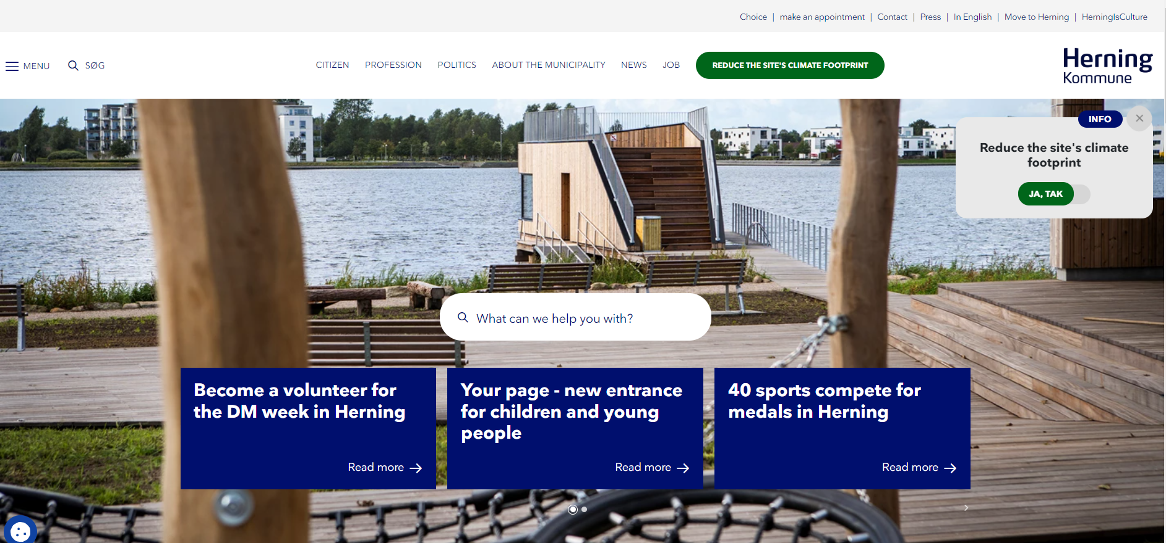
Low carbon mode wıth a sımple swıtch

Slide 34
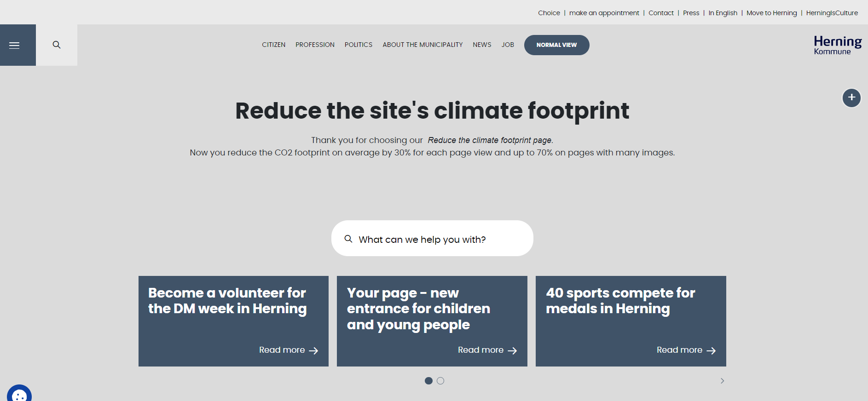
Low carbon mode wıth a sımple swıtch

Slide 35

What else?

Slide 36
Securıty, better together vs. Better apart and more...
There is a lot more to talk about good software design, and options vary depending on the project.

Slide 37
acknowledgements

Slide 38
acknowledgements
A Philosophy of Software Design, John Ousterhout
Extreme Programming Explained, Kent Beck & Cynthia Andres
Clean Architecture: A Craftsman’s Guide to Software Structure and Design, Robert C. Martin
Clean Code: A Handbook of Agile Software Craftsmanship, Robert C. Martin
Software Modularity – An Introduction to Strategic Software Modularization, Karl Bråtegren
Scrum Guide, Ken Schwaber and Jeff Sutherland
Designer AI Image Creator

Slide 39



Thank you!
https://umbracocommunity.social/@nurhakkaya14
https://twitter.com/nurhakkaya14
https://www.linkedin.com/in/nurhak-kaya
https://github.com/NurhakKaya

